Slide 1
Zimbra Collaboration
Environment Knowledge Transfer for BCC
SYNACOR PROFESSIONAL SERVICES
January , 2025

Slide 2
Schedule
Day 1
Overall Architecture
HLD Understanding and Detailing
Day 2
LDAP Tier
Proxy Tier
MTA Tier
Day 3
Mailstore Tier
Logger server
LDS server
Day 4
Best Practices
Monitoring Cadence
Minimum Automated System Monitoring
Operational Staffing
Typical Tiered Support Model
ZCS Key Performance Indicators
Day 5
Software Updates and Staging Lab
Administrative Model

Slide 3
Overall Architecture

Slide 4
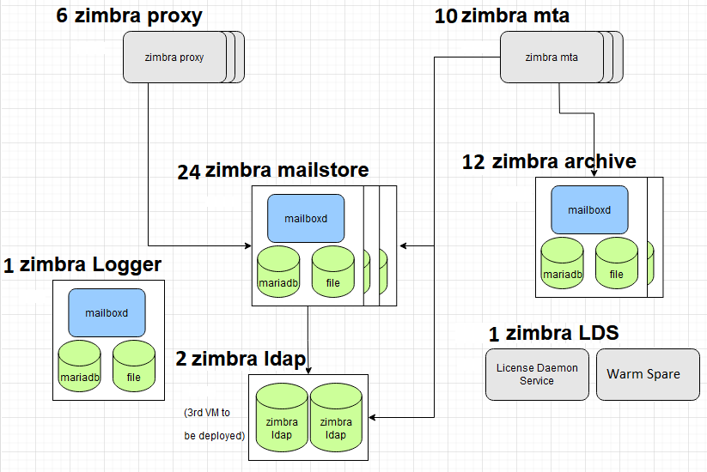
Overall Architecture
Placeholder (Slide Content TBD
Role | Number of Servers | Memory | vCPU
LDAP | 2 | 16GB | 4
Proxy | 6 | 12GB | 4
MTA | 10 | 12 GB | 4
Mailstore | 24 | 24 GB | 4
Logger | 1 | 12 GB | 4
LDS | 1
Archive | 12 | 16 GB | 4
NFS (mailstore zmbackup) | 24

Slide 5
Understanding the LDAP Tier
Considerations
OpenLDAP has tremendous scale, meaning it can support millions of objects, prior Zimbra customers in India and Japan have eclipsed 5 million objects.
Zimbra supports OpenLDAP’s Multi-Master replication model, Master-Replica model, and the delta-sync-repl engine.
The number of objects within the Zimbra LDAP for BCC, even with growth will likely be less than 200,000.
Based on this number of objects the /opt/zimbra/data/ldap/mdb/db/data.mdb will likely be less than 2GB, but will grow with some natural fragmentation (perhaps to 4GB)
The architecture of OpenLDAP uses LMDB (lightning memory-mapped database), which stores the content of data.mdb entirely in memory.
Each LDAP VM then requires enough memory for Linux in general + the size of the data.mdb + potential growth of data.mdb when natural fragmentation occurs, hence we recommend a safe size of 4vCPU x 16GB memory (just 100GB of disk required, should be from SAS tier).

Slide 6
Understanding The LDAP Tier (Continued)

Slide 7
Understanding the LDAP Tier (Continued)
Best Practices Explained
Reciprocal agreements between ldapm1 and ldapm2, ldapm1 and ldapm3, in what is known as “chained replication” model (do not use fully meshed, no agreement should exist between ldapm2 and ldapm3)
All writes should always go to 1 LDAP Master, which avoids need for conflict resolution logic with slapd
Conflict resolution logic occurs if there was a fully meshed environment (each LDAP Master has a reciprocal agreement with the other two). If a write goes to ldapm1, it is immediately pulled by ldam2 and ldapm3 at the same time, they intern will then pull the same update from each other resulting in a conflict – which should be avoided.
If either LDAP Master goes down, all non-LDAP Zimbra servers will failover to the other Master and service will be continuous (based on properly configured ldap_master_url and ldap_url in all non-LDAP servers).
All read traffic goes to ldapm2, all write traffic goes to ldapm1
ldapm3 is for DR purposes, should be in a separate DC, but technically any off-site location outside of the primary DC is acceptable
  if there was a disaster in primary DC (major outage) this Master would be up to date with all objects
  depending on network connectivity between primary DC and off-site location of this Master, it could be used as the tertiary Master (occupies the 3rd slot of both ldap_master_url and ldap_url
  ldapm3 could be implemented later provided nightly backups of ldapm1 and ldam2 are being saved somewhere outside the DC
The default configuration of a LDAP Master are sufficient (no settings changes are required)

Slide 8
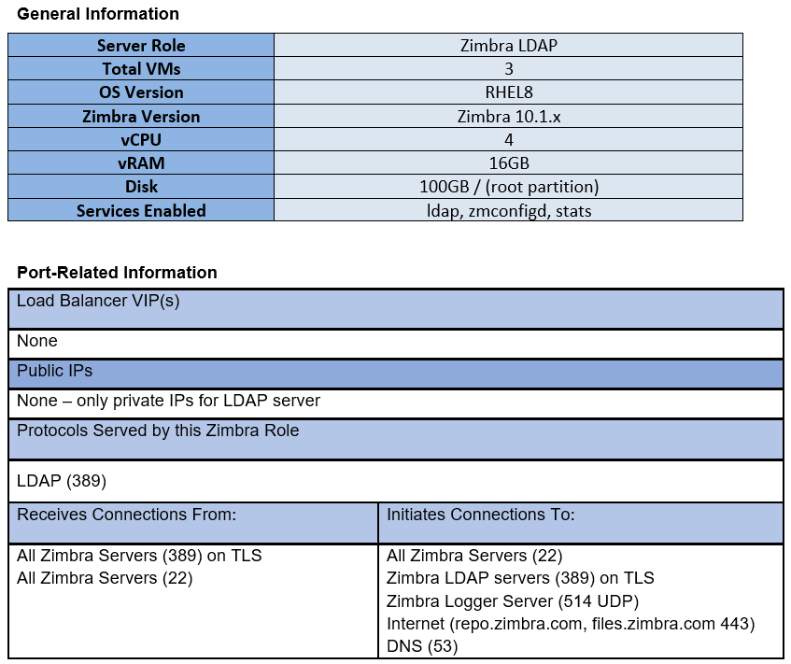
Understanding the LDAP Tier (Continued)

Slide 9
Understanding the LDAP Tier (Continued)
Is port 389 listening?
  From another Linux host on the private network execute: nc –zv ldapm1.xyz.net 389 (optionally use telnet) or in general a larger bash script that checks all ports on all Zimbra servers
  Use OpenSource Monitoring solution with Port Check routines
  Use free Monitoring Dashboards (uptimerobot.com and similar)
Is the LDAP service OK?
Typically, you simply need to tail the zimbra.log (tail –f /var/log/zimbra.log), but to see if it returns search results, you can use ldapsearch (can be done from a Zimbra mailstore or the LDAP VM itself, or another LDAP VM)
[zimbra@ldapm1 ~]$ zmsetvars
[zimbra@ldapm1 ~]$ ldapsearch -x -H $ldap_master_url -D $zimbra_ldap_userdn -w $zimbra_ldap_password -LLL -b 'ou=people,dc=bcc,dc=gov,dc=bd’
Are the services (zmconfigd, ldap, stats) running?
With the logger service setup, connect to the Logger host with the Admin Console, the up/down status of the services of all Zimbra services will be available
Use OpenSource Monitoring (Zabbix, Nagios) with Service Check routines

Slide 10
Understanding the LDAP Tier (Continued)
Is there sufficient disk space?
Use Linux OS (df –h)
Use OpenSource Monitoring (Zabbix, Nagios) with Disk Check routines
Is the zimbra.log being written, rolled and gzipped, and pruned?
Inspect /var/log directory on each LDAP VM (ls -l /var/log/zimbra*)
Is the zmstats data being written, gzipped and stored?
Inspect /opt/zimbra/zmstat directory on each LDAP VM (ls –l /opt/zimbra/zmstat, ls –l /opt/zimbra/zmstat/2024-12-17)
Are the backups running?
Inspect /var/log directory on each LDAP VM (ls –l /opt/zimbra/backup/sessions)
Use zmbackupquery ([zimbra@ldapm1 ~] zmbackupquery | head -10)
Is Linux OS Health OK?
Generally considered outside the scope of Zimbra but there are plenty of OpenSource tools or general tools available in Linux to examine items like CPU usage, Load Average, Memory, etc, as well as general pings by FQDN.

Slide 11
Understanding the LDAP Tier (Continued)
Are the Masters in-sync?
Use zmreplchk (sometimes reports incorrectly if ldap_url and ldap_master_url are not conforming format)
Do what zmreplcheck does using ldapsearch
[zimbra@ldapm1 ~]$ for i in {1,2,3}; do echo -- zmldap$i -- && ldapsearch -xLLLH ldap://zmldap$i.bcc.gov.bd:389 -s base contextCSN | grep context | awk '{print $2}' | cut -c1-18 ;done
-- ldapm1 --
20200331040354.291350
20201022164935.359887
20201022202845.777115
-- ldapm2 --
20200331040354.291350
20201022164935.359887
20201022202845.777115
-- ldapm3 --
20200331040354.291350
20201022164935.359887
20201022202845.777115
Are the object counts in-sync on each Master?
[zimbra@ldapm1 ~]$ for i in {1,2,3}; do ldapsearch -LLL -x -h ldapm$i.bcc.gov.bd:389 -D 'uid=zimbra,cn=admins,cn=zimbra' -w B4V3iy5Mw '(&(objectclass=zimbraAccount)(mail=*))' zimbraMailDeliveryAddress | wc -l
74040
74040
74040
All numbers being identical implies we are in-sync

Slide 12
Understanding the LDAP Tier (Continued)
Is there fragmentation of the LDAP database?
Fragmentation of the LDAP Main database (path shown below) can occur over time and is recorded in what are known as “free pages” which are 4K bytes in size. The more free pages, the more fragmented the database is. With approximately 200K “objects” in LDAP (BCC current level + growth), the size of the data.mdb file should be somewhere between 500MB-700MB (size variance due to object size). You can review the current size (check on the new RHEL8 LDAP Masters, which should have nominal fragmentation) using:
[zimbra@ldapm1 ~]$ du -c -h /opt/zimbra/data/ldap/mdb/db/data.mdb
654M /opt/zimbra/data/ldap/mdb/db/data.mdb
654M total
Now we will count the free pages, and see how much data this represents (fragmentation)
[zimbra@ae-test-2-el8 ~]$ mdb_stat -f /opt/zimbra/data/ldap/mdb/db | grep "Free pages"
Free pages: 315
[zimbra@ae-test-2-el8 ~]$ mdb_stat -f /opt/zimbra/data/ldap/mdb/db | grep "Free pages" | awk '{print $3 * 4096/1024/1024 " MB"}'
1.23047 MB
So, as we can see, very minor. If the number of free pages is however consuming 50% of the size of the database (essentially the data.mdb is close to 1TB), then dump/reload (zmslapcat/zmslapadd) will defragment, but this should be a planned maintenance window.
Note the data.mdb is known as a “sparse” file, you cannot get the correct size using “ls –ltr”, it will show:
[zimbra@ldapm1 ~]$ ls -ltr /opt/zimbra/data/ldap/mdb/db/data.mdb
-rw-------. 1 zimbra zimbra 85899345920 Dec 17 23:24 /opt/zimbra/data/ldap/mdb/db/data.mdb

Slide 13
Understanding the LDAP Tier (Continued)
Understanding the Accesslog
The accesslog database functionality of OpenLDAP is where modifications to LDAP attribute values are stored, for other Masters or Replicas to fetch in order to remain in sync with the write Master. For example, a modification to an account as follows:
[zimbra@store1 ~]$ zmprov ma admin@botch.org zimbraPortalName cookie
Results in the following entry added to the end of the accesslog DB that looks like this:
dn: reqStart=20241222211218.000004Z,cn=accesslog
objectClass: auditModify
structuralObjectClass: auditModify
reqStart: 20241222211218.000004Z
reqEnd: 20241222211218.000005Z
reqType: modify
reqSession: 134432
reqAuthzID: uid=zimbra,cn=admins,cn=zimbra
reqDN: uid=admin,ou=people,dc=botch,dc=org
reqResult: 0
reqMod: zimbraPortalName:= cookie
reqMod: entryCSN:= 20241222211218.367059Z#000000#002#000000
reqMod: modifiersName:= uid=zimbra,cn=admins,cn=zimbra
reqMod: modifyTimestamp:= 20241222211218Z
reqEntryUUID: 16d90c8e-fe7e-103e-9398-cfa409af20b5
entryUUID: 2ba43abc-54f5-103f-85cb-33250ebb9f8c
creatorsName: cn=config
createTimestamp: 20241222211218Z
entryCSN: 20241222211218.367059Z#000000#002#000000
modifiersName: cn=config
modifyTimestamp: 20241222211218Z
The other Masters or Replicas will then poll the write Master and pull this update in milliseconds.

Slide 14
Understanding the LDAP Tier (Continued)
Checking for Excessive Attribute Modifications
The access log can be exported at anytime using the command:
[zimbra@ldapm1 ~]$ /opt/zimba/libxec/./zmslapcat –a /var/tmp
This will create ldap-accesslog.bak in /var/tmp, and contains all updates (adds/deletes/modifications) that have occurred in the last 24 hours with the most recent updates at the end of the log. We can sort this by operation to see if there some updates that are excessive.
[zimbra@ldapm1 ~]$ grep "reqMod" /var/tmp/ldap-accesslog.bak |egrep ':=|:+|:-' |egrep -v 'entryCSN|modifiersName|modifyTimestamp'| awk '{print $2}' | sort | uniq -c | sort -n
The output will show the attributes update count from least to most, so the end of the output would look like this…
388 zimbraPasswordLockoutFailureTime:-
571 zimbraPasswordLockoutFailureTime:+
616 zimbraQuotaLastWarnTime:=
910 zimbraSharedItem:=
1207 zimbraPrefMailTrustedSenderList:=
1572 zimbraAuthTokens:=
1809 zimbraNetworkRealtimeActivation:=
2072 zimbraLastLogonTimestamp:=
2863 zimbraPrefSortOrder:=
24501 zimbraAuthTokens:-
70293 zimbraDataSourceLastError:=

Slide 15
Understanding the LDAP Tier (Continued)
Checking for Excessive Attribute Modifications (Cont.)
We can see the last value is somewhat excessive, so you have to investigate further
70293 zimbraDataSourceLastError:=
[zimbra@saas-dev-md1 ~]$ zmprov desc -a zimbraDataSourceLastError
zimbraDataSourceLastError
If the last data source sync failed, contains the error message. If
the last data source sync succeeded, this attribute is unset.
type : string
value :
callback :
immutable : false
cardinality : single
requiredIn :
optionalIn : dataSource
flags : domainAdminModifiable
defaults :
min :
max :
id : 1029
requiresRestart :
since : 5.0.17
deprecatedSince :
The zimbraDataSourceLastError indicates there are misconfigured external POP or IMAP connections within the Zimbra Web Client, likely for multiple users.

Slide 16
Understanding the LDAP Tier (Continued)
External Data Sources
There is a potential problem surrounding external data sources when the connection is failing, meaning the user didn't set it up correctly (like wrong password, bad FQDN/endpoint address) and they had a very high polling frequency (1 minute), so every minute it would write the large zimbraDataSourceLastError, over and over.
ldapsearch -LL -x -h ldapmaster.xyz.net -D 'uid=zimbra,cn=admins,cn=zimbra' '(&(objectclass=zimbraDataSource)(zimbraDataSourceFailingSince=*))' -w xxxxxxxxx modifyTimesStamp zimbraDataSourceFailingSince zimbraDataSourceLastError zimbraDataSourceUsername zimbraDataSourceEmailAddress zimbraDataSourceId
If a datasource for an external POP/IMAP account connects successfully it will null out zimbraDataSourceFailingSince. So if you run that search above, and the modifyTimeStamp is very recent, there is a value in zimbraDataSourceLastError, and the zimbraDataSoureFailingSince does have a value, then that account is been failing since then. Example:
zimbraDataSourceEmailAddress: dave.smith@gmail.com
zimbraDataSourceFailingSince: 20190105151625Z
zimbraDataSourceLastError: system failure: error importing CalDAV data, DAV
server returned an error: 401
zimbraDataSourceId: 9c7ca14e-a659-4ce4-b4cd-e80790b87225
zimbraDataSourceUsername: dave.smith
modifyTimestamp: 20190423065912Z
That's a bad one, so every "polling interval" since January 5th, 2019 - it has been trying to connect. The zimbraDataSourceUsername is the person who setup this datasource (the account owner) and the zimbraDataSourceEmailAddress is what it fails to connect to. So what you could do, is disable it.
zmprov mds dave.smith@realdomain.net 9c7ca14e-a659-4ce4-b4cd-e80790b87225 zimbraDataSourceEnabled FALSE

Slide 17
Understanding the Proxy Tier
Considerations
The Zimbra proxy role is based on the very mature NGINX platform, which provides tremendous vertical scale (a single NGINX VM can support an extremely high number of connections), but also can support multiple VMs (a pool)
The usage of Layer-4 Load Balancing to distribute connections to a pool of Zimbra Proxy VMs is a best practice, not just for the purpose of balanced distribution across the pool but because L4LB incorporates TCP-level checks that ensure the destination host is actually available before sending the connection.
For many existing Zimbra customers in the range of 100,000 to 200,000 users, only 3-4 Zimbra Proxy servers are used
This could be double-checked on the zmstat recordings of the Zimbra Proxy VMs used in the ZCS 8.8.15 environment (observe memory consumption, load average, disk IO)

Slide 18
Understanding The Proxy Tier (Continued)

Slide 19
Understanding the Proxy Tier (Continued)
Best Practices Explained
Traffic should come through the Layer-4 Load Balancer in all cases, whether initiated from intranet or Internet and be restricted to ports 443 (HTTPS), 993 (IMAPS), 995 (POPS) and 9071 (Admin Console access)
The Layer-4 Load Balancer should have a VIP configured with the four Ips of the Proxy VMs, and use least connections algorithm for distribution, no persistence (aka stickiness) is required.
Port 80, 110 and 143 should not be allowed
Default configuration will be for the Proxies to route to back-end mailstores on 8443, 7993, 7995, 7071, 7072, 7073 and LDAP server on 389, which means all connections are encrypted.
Proxies need to reach each other on Memcached port 11211 (each proxy does not always query its own Memcached service, they will query other proxies as well)
Commercial SSL Certificates can be loaded in Zimbra Proxies or if Certificate Management is possible on the L4LB, can be loaded there
The default configuration on the Zimbra Proxies may have 80, 110 and 143 listening, however these should not be allowed through the external firewall (which would allow unencrypted traffic). Disabling these ports (such that they are not listening on the Proxies) is recommended.

Slide 20
Understanding The Proxy Tier (Continued)

Slide 21
Understanding the Proxy Tier (Continued)
Are the Proxy ports listening?
  From another Linux host on the private network, execute: for i in {443,993,995,9071}; do nc –zv proxy1.xyz.net $i; done (optionally use telnet) or in general a larger bash script that checks all ports on all Zimbra servers
  Use OpenSource Monitoring solution with Port Check routines
  Use free Monitoring Dashboards (uptimerobot.com and similar)
Is the Proxy service, OK?
You can use OpenSSL to simulate connections from the command line, initiated from any Zimbra server.
[zimbra@proxy1 ~]$ openssl s_client -connect vm1.zimbra1.lab:995
< cert information will display first >
+OK vm1.zimbra1.lab Zimbra POP3 server ready
user admin@zimbra1.lab
+OK hello admin@zimbra1.lab, please enter your password
pass zimbra
+OK server ready
list
+OK 2 messages
1 5247
2 22
.
quit
+OK vm1.zimbra1.lab Zimbra POP3 server closing connection
Closed
The above is for POPS, IMAPS would be: openssl s_client -connect vm1.zimbra1.lab:993

Slide 22
Understanding the Proxy Tier (Continued)
Are the services (proxy, memcached, zmconfigd, stats) running?
With the logger service setup, connect to the Logger host with the Admin Console, the up/down status of the services of all Zimbra services will be available
Use OpenSource Monitoring (Zabbix, Nagios) with Service Check routines
Is there sufficient disk space?
Use Linux OS (df –h)
Use OpenSource Monitoring (Zabbix, Nagios) with Disk Check routines
Are the nginx.log and nginx.access.log being written, rolled and gzipped, and pruned?
Inspect /opt/zimbra/log directory on each Proxy VM (ls -l /opt/zimbra/log/nginx*)
Is the zmstats data being written, gzipped and stored?
Inspect /opt/zimbra/zmstat directory on each Proxy VM (ls –l /opt/zimbra/zmstat, ls –l /opt/zimbra/zmstat/2024-12-17)
Is Linux OS Health OK?
Generally considered outside the scope of Zimbra but there are plenty of OpenSource tools or general tools available in Linux to examine items like CPU usage, Load Average, Memory, etc, as well as general pings by FQDN.

Slide 23
Understanding the MTA Tier
Considerations
The Zimbra MTA is bundled with Postfix which, like NGINX is a widely adopted and mature platform that has been used in Linux deployments for over 20 years.
The usage of Layer-4 Load Balancing to distribute connections to a pool of Zimbra MTA VMs is a best practice, not just for the purpose of balanced distribution across the pool but because L4LB incorporates TCP-level checks that ensure the destination host is actually available before sending the connection.
Typical deployments for larger customers (over 10,000 mailboxes) have non-Zimbra layer before the Zimbra MTAs, that provides anti-spam, anti-virus, anti-malware, anti-abuse capabilities, which ultimately then routes the connections to the Zimbra MTA layer, in which case the Zimbra Anti-Spam (SpamAssassin) and Anti-Virus (ClamAV) services are not necessary.
The MTA layer must have more disk to be able to spool messages for a certain amount of time should the delivery to the mailstores be blocked for some reason.

Slide 24
Understanding The MTA Tier (Continued)

Slide 25
Understanding the Proxy Tier (Continued)
Best Practices Explained
Traffic should come through the Layer-4 Load Balancer in all cases, whether initiated from intranet or Internet and be restricted to ports 25 (SMTP), 465 (SMTP submission from older thick clients), 587 (SMTP submission from newer thick clients)
The Layer-4 Load Balancer should have a VIP configured with the eight Ips of the Proxy VMs, and use least connections algorithm for distribution, no persistence (aka stickiness) is required.
Default configuration will be for the MTAs to route to back-end mailstores on 7025 (LMTP) or outbound on 25 (SMTP)
If the Zimbra Anti-Virus is being used, and because the recommendation is to use 16GB memory in the Zimbra MTAs, we also recommend using a 2 GB tmpfs file system for /opt/zimbra/data/amavisd/tmp
  https://wiki.zimbra.com/wiki/Tmpfs_for_amavisd-new
  https://wiki.zimbra.com/wiki/Anti-spam_Strategies#2._Put_Amavis.27s_Temp_Dir_on_a_RAM_Disk

Slide 26
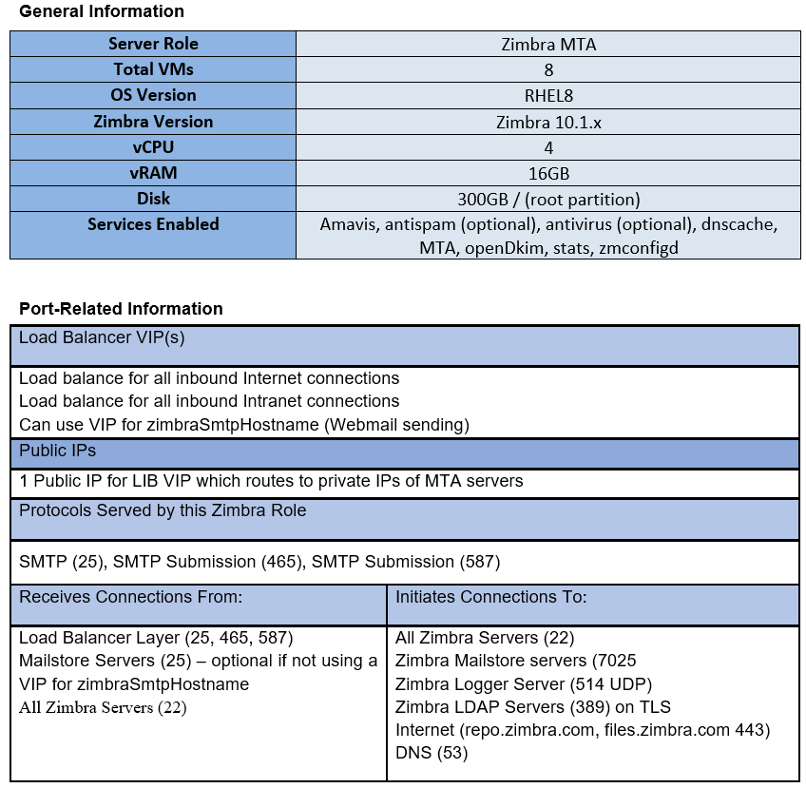
Understanding The MTA Tier (Continued)
If anti-spam (SpamAssassin) and anti-virus (ClamAV) are not used, you could drop the Memory amount to 12GB

Slide 27
Understanding the MTA Tier (Continued)
Are the MTA ports listening?
  From another Linux host on the private network, execute: for i in {25,465,587}; do nc –zv mta1.xyz.net $i; done (optionally use telnet) or in general a larger bash script that checks all ports on all Zimbra servers
  Use OpenSource Monitoring solution with Port Check routines
  Use free Monitoring Dashboards (uptimerobot.com and similar)
Is the MTA service, OK?
You can use NetCat (nc) or telnet to submit a message from the command line, initiated from any Zimbra server (operator types the bolded values)
[zimbra@proxy1 ~]$ telnet mta1.bcc.gov.bd 25
Trying 172.31.38.137...
Connected to vm1.zimbra1.lab.
Escape character is '^]'.
220 vm1.zimbra1.lab ESMTP Postfix
helo myVM
250 vm1.zimbra1.lab
ehlo u
250-vm1.zimbra1.lab
250-PIPELINING
250-SIZE 10240000
250-VRFY
250-ETRN
250-STARTTLS
250-ENHANCEDSTATUSCODES
250-8BITMIME
250 DSN
mail from: somembox@gmail.com
250 2.1.0 Ok
rcpt to: validuser@bcc.gov.bd
250 2.1.5 Ok
data
354 End data with <CR><LF>.<CR><LF>
Subject: Routing on Basic SMTP
Go baby.
.
250 2.0.0 Ok: queued as 803BAA377B
quit
221 2.0.0 Bye
Connection closed by foreign host.
This indicates it was successfully received by Postfix

Slide 28
Understanding the MTA Tier (Continued)
Is the MTA service, OK (Continued)?
Probably the fastest way is to tail the /var/log/zimbra.log to observe if there are bounces or failures.
Are the services (mta, amavis, antispam, openDkim,dnscache, zmconfigd, stats) running?
With the logger service setup, connect to the Logger host with the Admin Console, the up/down status of the services of all Zimbra services will be available
Use OpenSource Monitoring (Zabbix, Nagios) with Service Check routines
Is there sufficient disk space?
Use Linux OS (df –h)
Use OpenSource Monitoring (Zabbix, Nagios) with Disk Check routines
Are the logs being written, rolled and gzipped, and pruned?
Inspect /var/log/zimbra.log directory on each MTA VM (ls -l /var/log/zimbra.*)
If using ClamAV, inspect freshclam.log, clamd.log and spamtrain.log*
Is the zmstats data being written, gzipped and stored?
Inspect /opt/zimbra/zmstat directory on each MTA VM (ls –l /opt/zimbra/zmstat, ls –l /opt/zimbra/zmstat/2024-12-17)
Is Linux OS Health OK?
Generally considered outside the scope of Zimbra but there are plenty of OpenSource tools or general tools available in Linux to examine items like CPU usage, Load Average, Memory, etc, as well as general pings by FQDN.

Slide 29
Understanding the MTA Tier (Continued)
Are the mail queues OK under each MTA VM?
Use zmqstat (must be root user)
[root@mta1 ~]# /opt/zimbra/libexec/./zmqstat
hold=0
active=2
incoming=1
corrupt=0
deferred=3
Use Postfix qshape (as zimbra user) which gives insight by domain
[zimbra@mta1 ~]# /opt/zimbra/bin/qshape -s deferred | head
T 5 10 20 40 80 160 320 640 1280 1280+
TOTAL 20 0 0 0 0 0 0 0 0 4 16
botch.org 10 0 0 0 0 0 0 0 0 2 8
MAILER-DAEMON 10 0 0 0 0 0 0 0 0 2 8
Use Postcat to examine message in the queues
[root@ae-test-3-el8 ~]# cd /opt/zimbra/data/postfix/spool/deferred
[root@ae-test-3-el8 deferred]# ls /opt/zimbra/common/sbin/postfix ls -d * */*
ls: cannot access 'ls': No such file or directory
0 3/33C12617E046 4/48B58617E043 5/5F7656184450 7/7408B61B098A 8/868A56184459 A C E /opt/zimbra/common/sbin/postfix
1 4 5 6 7/75FEA61B098B 8/8A88C6184454 A/A697F6175F83 C/CE4486184453 E/E67B161B07FB
2 4/4415F617E04A 5/56DEA6175F81 6/6A271617E048 8 9 A/A863E6175F84 C/CEBA66184451 E/E99F7617E04B
3 4/46090617E04D 5/58DB861B0990 7 8/813E36184455 9/9A7ED617E057 B D F
[root@ae-test-3-el8 deferred]# /opt/zimbra/common/sbin/postcat -q E/E99F7617E04B
Use the Admin Console (excellent section for examining MTA Queues)

Slide 30
Understanding the Mailstore Tier
Considerations
The data moved from the each older (ZCS 8.8.15 OSE) mailstores should essentially be paired with one ZCS 10.x NE mailstore, meaning all data from a single ZCS 8.8.15 OSE mailstores data is migrated to single ZCS 10.x NE mailstore. This helps reduce storage consumption by preserving single-object store. If data from one ZCS 8.8.15 OSE mailstore were to be distributed amongst multiple ZCS 10.x mailstores, the overall storage consumption would rise. It should be noted that the zmdedupe should be executed periodically on the ZCS 10.x NE mailstore as the zmmboxmoves are occurring
This (the above) means the storage consumed on the existing ZCS 8.8.15 OSE mailstore, can be used for planning what will be consumed on its counterpart ZCS 10.x NE mailstore.
The usage of zmbackup on the ZCS 10.x NE mailstores needs to be accounted for.
General growth of mail data over time should be factored.
Future use of S3-type Storage should be considered in the overall design
Virtualization Platform resources, Storage types and availability (general datacenter infrastructure equipment)
Size variations – meaning not all ZCS 8.8.15 OSE mailstores have the exact same amount of data
Consider the filesystem and underlying SCSI devices (carved from SAS storage) should be expandable but also reducible

Slide 31
Understanding The Mailstore Tier (Continued)
Starting Design
Filesystem Size Used Avail Use% Mounted on
devtmpfs 12G 0 12G 0% /dev
tmpfs 12G 16K 12G 1% /dev/shm
tmpfs 12G 1.2G 11G 10% /run
tmpfs 12G 0 12G 0% /sys/fs/cgroup
/dev/mapper/vg--zimbra-root 20G 3.4G 17G 17% /
/dev/sda1 1014M 226M 789M 23% /boot
/dev/mapper/vg--zimbra-home 10G 104M 9.9G 2% /home
/dev/mapper/vg--zimbra-var 10G 1.5G 8.6G 15% /var
/dev/mapper/vg--zimbra-var_log 10G 1.6G 8.5G 16% /var/log
/dev/mapper/vg--zimbra-tmp 10G 123M 9.9G 2% /tmp
/dev/mapper/vg--zimbra-opt 11.0T 45G 11.0T 1% /opt
172.22.10.195:/zbackup01/nembox01.bcc.gov.bd 8.5T 4G 8.5T 99% /zimbra_backup
Design when S3 Storage Becomes Available

Slide 32
Understanding the Mailstore Tier (Continued)
Best Practices
Use “in-guest” NFS mounts for backups (cheaper)
  Properly configured in /etc/fstab
  Adjust zimbraBackupTarget (server config)
Reduce backup from 30 day delete to 7 day delete
  Edit crontab as zimbra user
Maximize memory of the VM with adjustments to the three key components of the Zimbra application
  mailboxd_java_heap_size (zmlocalconfig)
  zimbra_zmjava_options (zmlocalconfig)
  Innodb_buffer_pool_size (my.cnf)
Utilize flexible options to account for size variances (where one 8.8.15 mailstore may have significantly more or less than others)
  Use Linux LVM capabilities (thus vgextend/vgreduce, lvextend/lvreduce can be used)
  Additional SCSI devices + Zimbra’s zmvolume can be used at anytime
  Simply creating more mailstores is always an option
  Eventually with the S3 storage, provided it has enough capacity, all blobs stored on block storage can be moved to S3
S3 Storage Usage
  Must clarify the capabilities of the S3 storage (does it store a single or multiple copies of the objects/blobs?)
  As long as multiple copies are stored, the Zimbra backup can skip copying the blobs, which the reduces the NFS storage requirements (1/5th of the storage would be required, only Zimbra’s index and mySQL data backed up)

Slide 33
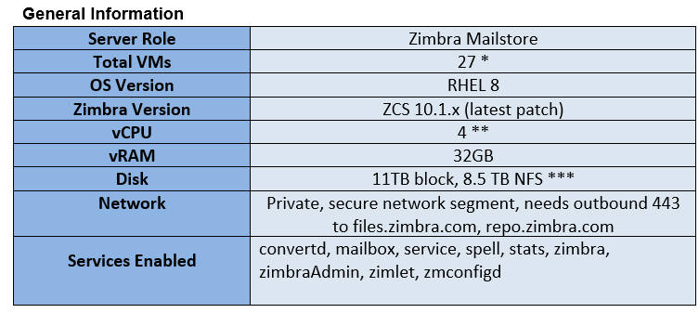
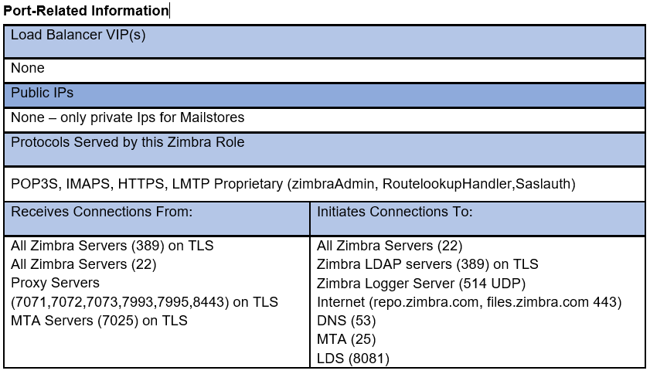
Understanding The MTA Tier (Continued)
27 is suggested, but this could be more or less, depending on the storage capacity
The recommendation for 4 vCPU is predicated on results of analysis for “load average” during peak times for the busiest mailstores within the 8.8.15 environment
The 11 TB of block storage, and 8 TB NFS storage capacity is based on:
The 10 TB average mailstore data amount across the 8.8.15 OSE mailstores, and thus provides another 1 TB of growth (consider 12 TB if S3 is not available within six months)
The fact that S3 storage will eventually be introduced, which when setup using Zimbra’s Hierarchical Storage Management (HSM), will effectively lower the amount of data consumed in /opt
In general, 50-65% of the /opt partition storage will be required for the data backed up by zmbackup. There are many things that effect this imprecise amount (attachments not compressed, index size, db size). 13 TB x .65 = 8.4 TB (implying, after the S3 is added if the combination of block storage + S3 storage grows to 13 TB total (30% growth), you are OK with 8.5TB in the NFS mount.

Slide 34
Understanding the Mailstore Tier (Continued)
Are the mailstore ports listening?
  From another Linux host on the private network, execute: for i in {7025,7071,7072,7073,7993,7995,8443}; do nc –zv store1.xyz.net $i; done (optionally use telnet) or in general a larger bash script that checks all ports on all Zimbra servers
  Use OpenSource Monitoring solution with Port Check routines
  Use free Monitoring Dashboards (uptimerobot.com and similar)
Are the mailstore services, OK?
With the logger service setup, connect to the Logger host with the Admin Console, the up/down status of the services of all Zimbra services will be available
zmcontrol status
Use OpenSource Monitoring (Zabbix, Nagios) with Service Check routines
tail –f /opt/zimbra/log/mailbox.log
Review /opt/zimbra/log/zmmailboxd.out
The same checks against the Proxy tier using OpenSSL for IMAP and POP are validating the mailbox can be accessed
Is there sufficient disk space?
Use Linux OS (df –h)
Use OpenSource Monitoring (Zabbix, Nagios) with Disk Check routines
Are the logs being written, rolled and gzipped, and pruned?
Inspect /opt/zimbra/log directory on each Mailstore VM
  access_log*, audit.log*, mailbox.log*, sync.log*, trace_log*, zmconfigd-log* and zmmailboxd.out* all should be rolled and pruned.

Slide 35
Understanding the Mailstore Tier (Continued)
Is the zmstats data being written, gzipped and stored?
Inspect /opt/zimbra/zmstat directory on each MTA VM (ls –l /opt/zimbra/zmstat, ls –l /opt/zimbra/zmstat/2024-12-17)
Is Linux OS Health OK?
Generally considered outside the scope of Zimbra but there are plenty of OpenSource tools or general tools available in Linux to examine items like CPU usage, Load Average, Memory, etc, as well as general pings by FQDN.
Are the Reports Accumulating?
Verify the localconfig value for smtp_destination is set to a valid mailbox (this is often misconfigured)
  You could create a distribution list with multiple recipients who would be interested in the reports, then set smtp_destination to the email address of the DL.
  Reports on zmbackup, client usage, aggregate quote usage should all be in the designated mailbox.

Slide 36
Understanding the Logger Server
Considerations
The logger server is essentially a mailstore server that has the logger service added.
The logger server however should not contain mailboxes, implying it’s zimbraId should not existing the zimbraMailHostPool of any Class of Service.
In a multi-server Zimbra installation, there can only be only one logger server, while the rest of the servers are viewed as clients.
The logger service is known as non-essential, meaning none of the other servers depend on the logger service to be running (if the service is down, there will be no issues with the overall mail service), which negates any need for High Availability.
If choosing to not allow connections to the Admin Console through the Proxy servers on 9071 (if you only allow secured, intranet-only), the logger server should be used via port 7071.
Using S3 storage is not an option with the logger server (there are no blobs written), only direct SCSI devices (hard drives of the Virtual Machine) should be used.

Slide 37
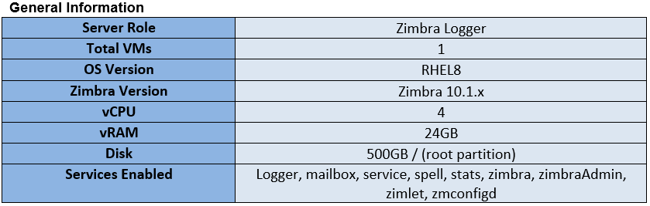
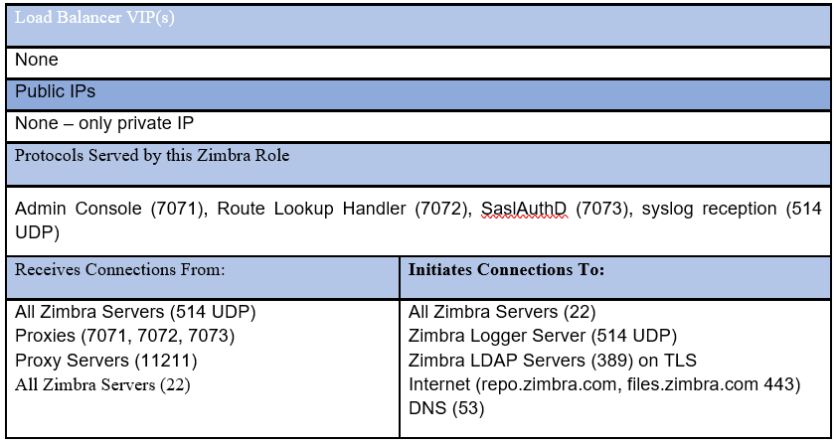
Understanding The Logger Server (Continued)
If Logger server from 8.8.15 env. exists, study its disk used, size similarly
Port-Related Information

Slide 38
Understanding the LDS Server
Introduction
The License Daemon Service (LDS) is a new service (introduced in 10.1.x) that communicates with the Zimbra License Server (license.zimbra.com) over 443
A new format of the license, an 18-26 alphanumeric character key has been introduced replacing the older .xml file format.
Zimbra Collaboration licenses are restrictive to the entitlement defined within the license and do not support multiple activations.
Once the Zimbra Collaboration license is activated no future license management by the user is required. License management is real-time and is managed by Zimbra.
An offline license server has been introduced to support environments that don’t have access to the public network.
All data gathered is based on license requirements and total usage which meets GDPR and other legal regulations.
Independent lab licenses are available. Contact Zimbra Sales or Support team.

Slide 39
Understanding the LDS Server
Considerations
The License Daemon Service (LDS), stats and zmconfigd are the only services that run on this VM, and the resource consumption will be very, very slow.
The current Zimbra release (10.1.x) supports a single LDS service node running within a Zimbra environment, but future release will incorporate a highly available architecture.
If LDS crashes, a "grace period" for the license is automatically instated. During that grace period, there is some functionality that is disabled and some that continues to be available.
Consider the VMware type functionality that may be possible in Nutanix that would assist.
  VMware HA
  Scheduled Snapshots
  VMware Fault Tolerance
In case of a disaster scenario, you may lose the LDS node. If you have a backup (a snapshot), you can restore the node from it.
In case you do not have a backup, then you will have to rebuild a new LDS node, hence a stand-by should be ready. It should only take 15 minutes (approximate), so have the software (ZCS 10.1.x) on the stand-by node, and unzipped, ready to run install.sh it will shorten the time. Note – you must contact the Zimbra Support team to get the device id deleted for the license. Once the device id is deleted, the dedicated LDS will automatically assign the new device id and the mailbox servers will get connected to the dedicated LDS.

Slide 40
Understanding the LDS Server
Available Functionality During Grace Period
Email Operations - All the email operations will continue to function and there will be no impact or interruption for the end users.
Account modification - Users can modify any of the settings for their account. E.g. creating signatures or filters, changing password, etc.
Network features - All the network features will continue to function except restoring of an account.
Not Available Functionality During Grace Period
You cannot create a new user or delete an existing user.
You cannot modify/update the following features for the existing users - EWS, SMIME, ActiveSync & ZCO
You cannot restore the account from a backup.

Slide 41
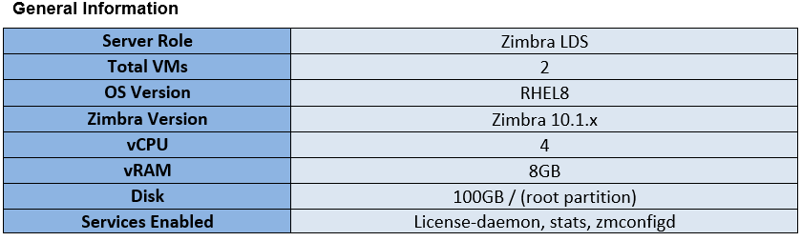
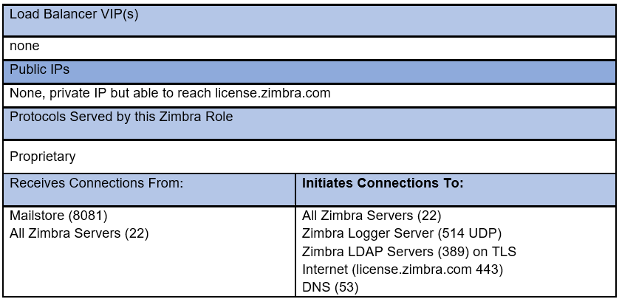
Understanding The LDS Server (Continued)
The second LDS VM is optional and considered a “stand-by” VM
Port-Related Information

Slide 42
Understanding the LDS Server
Are the LDS ports listening?
  From another Linux host on the private network, execute: nc –zv lds1.xyz.net 8081 (optionally use telnet) or in general a larger bash script that checks all ports on all Zimbra servers
  Use OpenSource Monitoring solution with Port Check routines
  Use free Monitoring Dashboards (uptimerobot.com and similar)
Are the LDS services, OK?
With the logger service setup, connect to the Logger host with the Admin Console, the up/down status of the services of all Zimbra services will be available
zmcontrol status
Use OpenSource Monitoring (Zabbix, Nagios) with Service Check routines
tail –f /opt/zimbra/log/license-daemon-service.log

Slide 43
Implementing the LDS Server In Upgrade to 10.1
Same Order as Any Zimbra Multi-Server Upgrade
LDAP Tier
Proxy Tier
MTA Tier
Mailstore Tier
Logger
Nuances
When you upgrade the LDAP Masters, they will ask for the new license key, but you will not be adding the LDS service itself
The next step is to install the LDS Node (install.sh, just install the LDS service and stats. Note that you have not activated the license yet, do not need too. Run zmlicensectl –service status to verify the license daemon service is running.
Upgrade the Proxy Tier to 10.1.x
Upgrade the MTA Tier to 10.1.x

Slide 44
Understanding the LDS Server
Upgrading the First Mailstore to 10.1.x
When you upgrade (install.sh) the first mailstore, it will ask for the zimbra-license-daemon host
Have you installed zimbra-license-daemon package on different node [N] y
Please enter the zimbra-license-daemon host [] lds1.bcc.gov.bd
And you'll get this during the setup menus
23) Enable version update notifications: TRUE
24) Install mailstore (service webapp): yes
25) Install UI (zimbra,zimbraAdmin webapps): yes
**26) License Activation: UNSET
Select, or 'r' for previous menu [r] 26
1) Activate license with installation
2) Activate license after installation
Select, or 'r' for previous menu [r] 2
If you chose option 2 above, after the install completes you can just do this...
zimbra@ae-test-6-el8 ~]$ zmlicense -a 539235993508671661
License activation for 539433993508671661 is successful, status : REGULAR LICENSE ACTIVE
At this point running zmlicense -p and -c on the 10.1 mailstore will show you the new license info, zmlicense -p and -c on the old mailstore will continue to show the old license data.

Slide 45
ZMSTAT and ZMSTAT-CHART Advanced Topics
About zmstat
The zmstat facility within Zimbra is often overlooked, but it can be used as a valuable tool for troubleshooting, reporting and trending.
The contents of /opt/zimbra/zmstat on all Zimbra servers is being updated with statistics typically every 30 or 60 seconds. If we look at all values (columns) of any of the stats files collected in /opt/zimbra/zmstat, we can realize how much is there. For example, we can look back at a particular day and study the mailbox statistics. Notice the vast amounts of columns.
[zimbra@store1 2020-10-05]$ zcat mailboxd.csv.gz | head -1
timestamp,lmtp_rcvd_msgs,lmtp_rcvd_bytes,lmtp_rcvd_rcpt,lmtp_dlvd_msgs,lmtp_dlvd_bytes,db_conn_count,db_conn_ms_avg,ldap_dc_count,ldap_dc_ms_avg,mbox_add_msg_count,mbox_add_msg_ms_avg,mbox_get_count,mbox_get_ms_avg,mbox_cache,mbox_msg_cache,mbox_item_cache,soap_count,soap_ms_avg,imap_count,imap_ms_avg,pop_count,pop_ms_avg,idx_wrt_avg,idx_wrt_opened,idx_wrt_opened_cache_hit,calcache_hit,calcache_mem_hit,calcache_lru_size,idx_bytes_written,idx_bytes_written_avg,idx_bytes_read,idx_bytes_read_avg,bis_read,bis_seek_rate,db_pool_size,innodb_bp_hit_rate,lmtp_conn,lmtp_threads,pop_conn,pop_threads,pop_ssl_conn,pop_ssl_threads,imap_conn,imap_threads,imap_ssl_conn,imap_ssl_threads,http_idle_threads,http_threads,soap_sessions,mbox_cache_size,msg_cache_size,fd_cache_size,fd_cache_hit_rate,acl_cache_hit_rate,account_cache_size,account_cache_hit_rate,cos_cache_size,cos_cache_hit_rate,domain_cache_size,domain_cache_hit_rate,server_cache_size,server_cache_hit_rate,ucservice_cache_size,ucservice_cache_hit_rate,zimlet_cache_size,zimlet_cache_hit_rate,group_cache_size,group_cache_hit_rate,xmpp_cache_size,xmpp_cache_hit_rate,gc_g1_young_generation_count,gc_g1_young_generation_ms,gc_g1_old_generation_count,gc_g1_old_generation_ms,gc_minor_count,gc_minor_ms,gc_major_count,gc_major_ms,mpool_codeheap_'non-nmethods'_used,mpool_codeheap_’non-nmethods'_free,mpool_metaspace_used,mpool_metaspace_free,mpool_codeheap_'profiled_nmethods'_used,mpool_codeheap_'profiled_nmethods'_free,mpool_compressed_class_space_used,mpool_compressed_class_space_free,mpool_g1_eden_space_used,mpool_g1_eden_space_free,mpool_g1_old_gen_used,mpool_g1_old_gen_free,mpool_g1_survivor_space_used,mpool_g1_survivor_space_free,mpool_codeheap_'non-profiled_nmethods'_used,mpool_codeheap_'non-profiled_nmethods'_free,heap_used,heap_free
(note - use cat if the file does not have .gz extension)

Slide 46
ZMSTAT and ZMSTAT-CHART Advanced Topics
You can isolate on a particular column (in this case: lmpt_rcvd_msgs), for a particular time period.
[zimbra@store1 2020-10-05]$ zcat mailboxd.csv.gz | awk -F, -v OFS=, '{print $1,$2}' | head -1
timestamp,lmtp_rcvd_msgs
[zimbra@store1 2020-10-05]$ zcat mailboxd.csv.gz | awk -F, -v OFS=, '{print $1,$2}' | egrep '2020 07:0'
10/05/2020 07:00:40,116
10/05/2020 07:01:40,206
10/05/2020 07:02:40,262
10/05/2020 07:03:40,233
10/05/2020 07:04:40,241
10/05/2020 07:05:40,225
10/05/2020 07:06:40,135
10/05/2020 07:07:40,93
10/05/2020 07:08:40,72
10/05/2020 07:09:40,92
So this tells me for the first 10 minutes after 7:00am, how many messages were injected into this mailstore (LMTP) each minute.
[zimbra@store1 2020-10-05]$ zcat mailboxd.csv.gz | awk -F, -v OFS=, '{print $1,$102,$103}' | head -1
timestamp,heap_used,heap_free
[zimbra@store1 2020-10-05]$ zcat mailboxd.csv.gz | awk -F, -v OFS=, '{print $1,$102,$103}' | egrep '2024 09:00’
10/05/2020 09:00:07,2926220288,12499453440
At 9:00am, my 4GB Java Heap had about 2.8GB free,about 1.2GB used

Slide 47
ZMSTAT and ZMSTAT-CHART Advanced Topics
Making a useful web site out of zmstats and zmstat-chart
You can use the Zimbra logger server, which will have Apache (httpd) running. First, make sure the Linux host (the logger server in this case) that will be providing the web service (to display the stats) has the following:
[root@log1]# yum install fontpackages-filesystem stix-fonts dejavu-fonts-common fontconfig dejavu-sans-mono-fonts
Generating the zmstat-chart.xml and modifying it for a particular server name
[zimbra@log1 ~]$ zmstat-chart-config > /opt/zimbra/conf/zmstat-chart.xml
[zimbra@log1 ~]$ sed -i ‘s/log1.bcc.gov.bd/store1.bcc.gov.bd/g' /opt/zimbra/conf/zmstat-chart.xml
Creating base directory
[root@log1 ~]# cd /var/tmp
[root@log1 tmp]# mkdir chart
[root@log1 tmp]# cd chart
Assuming a .tgz of the /opt/zimbra/zmstat on a particular Zimbra server has been created and copied to the web server host (in /home/user as an example), we first extract it in the directory created above.
[root@log1 chart]# tar zxvf /home/user/store1.tgz
[zimbra@log1 ~]$ mkdir /opt/zimbra/jetty/webapps/zimbra/public/zm-mailstr1
[zimbra@log1 ~]$ zmstat-chart -s /var/tmp/chart/ -d /opt/zimbra/jetty/webapps/zimbra/public/store1/
At this point if you navigate to http://log1.bcc.gov.bd/public/store1/index.html - you will see all statistics from that time that original .tgz was created until 12:00am

Slide 48
ZMSTAT and ZMSTAT-CHART Advanced Topics
Making a useful web site out of zmstats and zmstat-chart
Now let’s tie it all together, what you could do
On logger server we increase the directory structure under Apache (/opt/zimbra/jetty/webapps/zimbra/public/)to include all Zimbra servers (store2, store3, mta1, proxy1, etc.)
Every 15 minutes, on each Zimbra server, there are tasks execute by root (cron)
cd /opt/zimbra/zmstat
tar cvzf `hostname`.tgz *
scp `hostname`.tgz log1.bcc.gov.bd:/var/tmp/chart/.
Every 15 minutes on the log1 server, there are tasks executed by root (cron)
cd /var/tmp
tar zxvf store1.tgz
su - zimbra -c '/opt/zimbra/bin/zmstat-chart -s /var/tmp/chart/ -d /opt/zimbra/jetty/webapps/zimbra/public/store1/’
rm –rf *.gz
tar zxvf store2.tgz
su - zimbra -c '/opt/zimbra/bin/zmstat-chart -s /var/tmp/chart/ -d /opt/zimbra/jetty/webapps/zimbra/public/store1/’
rm –rf *.gz
Etc (continue for all servers)
You will have full charts/stats of all Zimbra servers, to study for trending, peaks, etc – and even if they 15 minutes old (max) it sometimes helps when there are real-time issues to be able to see statistics through out the day.

Slide 49
THANK YOU!

