Slide 1
CRPF
Architecture and mail collaboration explained

Slide 2
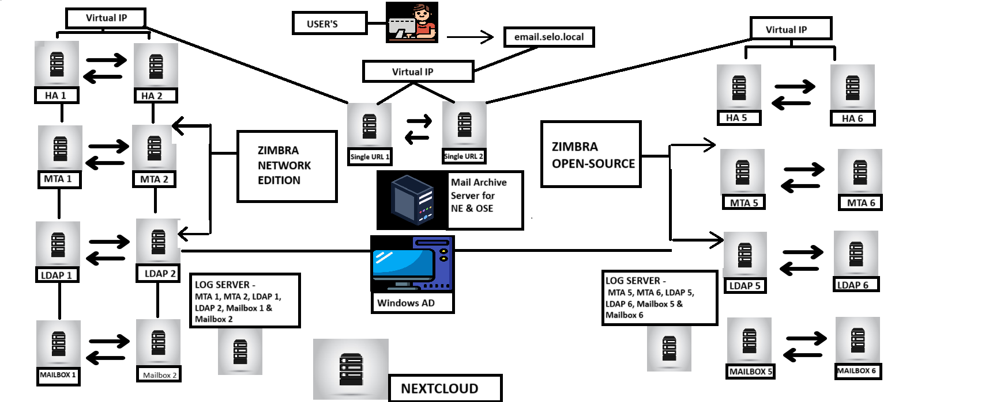
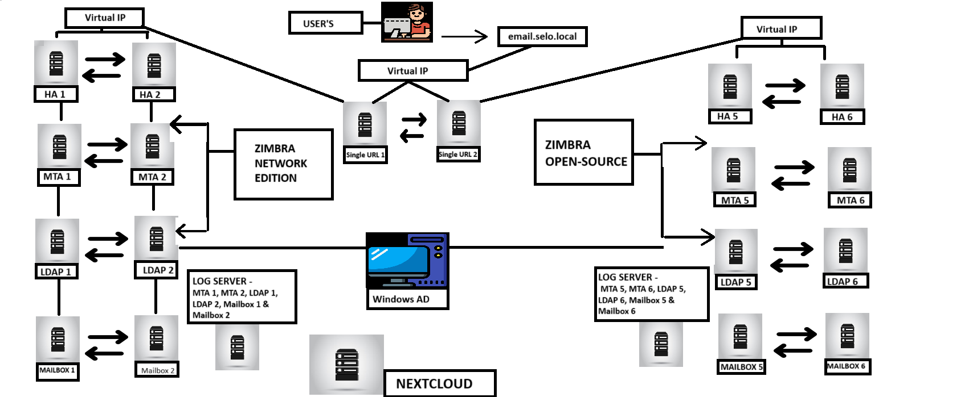
Architecture

Slide 3
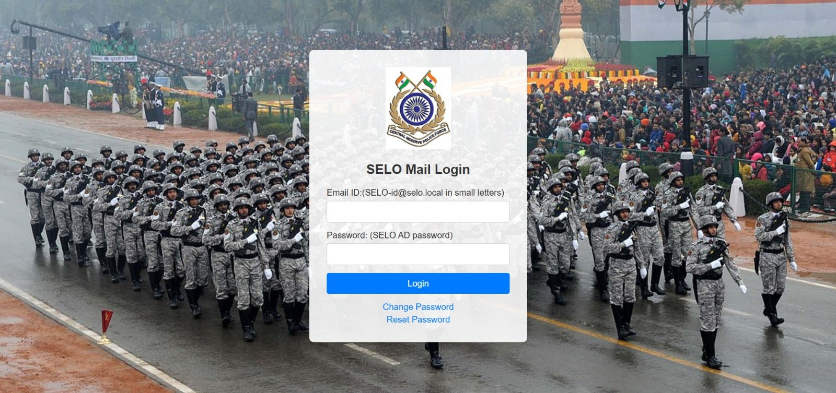
USER LOGIN INTERFACE

Slide 4
ZIMBRA NE (NETWORK-EDITION) AND ZIMBRA OPEN-SOURCE
We have around 15 thousand users and total 429 domains
We have implemented 2 Zimbra Multi-Server instances one is Network Edition and Second is Open-Source Edition.
This setup is completely Local setup we have implemented this without internet.
Integrated points with Zimbra
Ad authentication
GAL sync with AD server
Domain to Domain Restriction
Zimbra LOGO change in user dashboard

Slide 5
Modifications List
Single URL (via Pyhton Flask Application)
Modify Mail bounce back delay time
Create Alias for all accounts
Change sending address for all accounts
Change user dashboard logout URL
Split domaining from NE to OSE and OSE to NE

Slide 6
WHY USE SINGLE URL Concept
The client requirement was that we need 2 instances, first network edition and second open source and user should not know on which server he is logging in, network edition or open source edition. For this we used flask application the user will open on web (email.selo.local) and on the server on which the user is present, the flask application will log him in to the user server.

Slide 7

NEXTCLOUD LOGIN INTERFACE

Slide 8
Nextcloud Modification And client requirements
The client's requirement was that no user should be able to upload anything, only the documents shared by the admin should be visible and the user's options like dashboard or anything else should not be visible, only the files option should be visible
We have around 50 thousand user’s
Modify Nextcloud Logo
Modify login page
Set all user’s quota 0 KB
Disable option (dashboard weather etc only Files option is visible)

Slide 9

THANKS & REGARDS

